Slide 1

CMR COLLEGE OF ENGINEERING & TECHNOLOGY
Kandlakoya, Medchal, Hyderabad - 501401
Department of Computer Science and Engineering
PREDICTING DIABETES IN PREGNANT WOMANS AND NEONATAL MELLITUS IN NEW BORN CHILD USING MACHINE LEARNING
Batch No.: 76
Name of the student:
G. Mahendra (21H55A0504)
H. Lakshman (21H55A0508)
M. Jyoshna (21H55A0513)
Under esteemed guidance of
Mr.J.Ranjith (Assistant professor)
Batch: 2020-2024 Major Project Phase 1

Slide 2
Outline
Abstract
Introduction
Research Objective
Problem Definition
Scope of the Project
Literature Review
Implementation of Existing system
Conclusion
References
Notes:
2

Slide 3
Abstract
Notes:
3

Slide 4
ABSTRACT
Diabetes during pregnancy is a major source of health problems in unborn infants and their moms. Because gestational diabetes can develop to permanent diabetes, Machine Learning is an important method for predicting the likelihood of such progression based on the given features. As a result, new characteristics are required to improve the forecasting of neonatal mellitus and provide the most accurate diabetes persistence results in pregnant women. Python scripting and the application of Machine Learning methods such as Support Vector Machines, K Nearest Neighbours, and Logistic Regression can assist in achieving this aim. The preprocessing ML dataset focusing on Diabetes from the Pima Indian diabetes database collected through Kaggle. In addition, two new attributes were added to the project's dataset. According to research, machine learning models using characteristics like SVM and decision trees may successfully predict the risk of diabetes in pregnant women.

Slide 5
INTRODUCTION
Notes:
5

Slide 6
Introduction
Machine learning algorithms utilize previous data to discover patterns and make predictions about new data. In the case of diabetes prediction, machine learning algorithms may use data from electronic health records, clinical notes, test findings, and patient demographics to identify people at risk of acquiring diabetes. Several research have looked at the use of ML algorithms to predict diabetes in pregnant women and neonatal diabetes in babies. One research, for example, employed ML algorithms to for see the risk of gestational diabetes in pregnant women based on demographic and clinical variables. In terms of predicting gestational diabetes, the algorithm has an accuracy of 89.4%.
Notes:
6

Slide 7
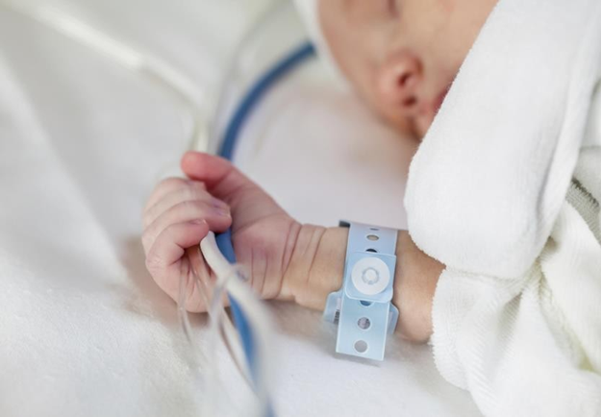
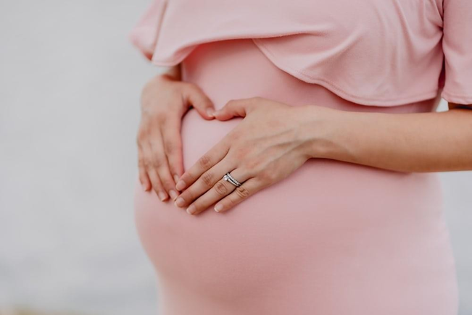
Healthy and happy

Slide 8
Research Objective
Notes:
8

Slide 9
Research objective
The project's goal is to use machine learning techniques to forecast the risk of permanent diabetes in pregnant women and Neonatal Mellitus mellitus in newborn children. By developing machine learning models and providing a user interface for on-spot data calculation, the project seeks to facilitate early detection and prevention of diabetes in these populations. Large datasets will be analysed using machine learning algorithms to uncover patterns and risk variables related with persistent diabetes in pregnant women and Neonatal Mellitus diabetes in newborns. By training these models on comprehensive and diverse datasets, the goal is to ensure their reliability and generalizability in real-world scenarios.

Slide 10
Problem Definition
Notes:
10

Slide 11
Problem Definition
Diabetes is a chronic condition that affects millions of individuals all over the world and can have major health repercussions, particularly during pregnancy. Gestational diabetes mellitus (GDM) is a frequent condition that can result in neonatal mellitus in neonates. Early identification and treatment of GDM are critical for avoiding negative effects for both the mother and the child. Current GDM detection approaches rely heavily on blood glucose tests and clinical risk factors.

Slide 12
Scope of the Project
Notes:
12

Slide 13
Scope of the Project
The potential of machine learning to predict gestational diabetes and neonatal mellitus is promising and encompasses several potential advancements and areas of exploration. Here are some key aspects that offer significant opportunities for further development.
Accuracy- Researchers can focus on refining existing machine learning models and developing more advanced algorithms to improve the accuracy of predictions. This involves incorporating additional data sources, such as genetic information or novel biomarkers, to enhance the predictive power of the models.

Slide 14
Literature Review
Notes:
14

Slide 15
Comparison table for the existing system
S.No | Authors and Journal Name& Year of publication | Problem Statement/ Title | Name of the Proposed solution/Method | Results/Remarks | Accuracy
1 | AVSriniva, Abbireddy Ramya, G.Chandralekha (2022) | “Prediction of diabetes using Machine Learning” | Random Forest, SVM, Logistic Regression. | When compared to other models, Random Forest provided the best accuracy | 92%
2 | Quan Zou, Kaiyang Qu, Yamei Luo (2018) | “Predicting Diabetes Mellitus with Machine Learning Techniques” | Random forest , Decision tree , Neural network | When all of the characteristics were considered, the prediction with random forest had the maximum accuracy | 0.8084
3 | Zahura Zaman , Md. Ashrak Al Arif Shohas, Mahedi Hasan ,Meherab Hossain (2022) | “Assessing Machine Learning Methods for Predicting Diabetes among Pregnant Women.” | SVM, Decision tree, Naive Bayes. | The most accurate method was determined to be logistic regression | 78.01
4 | Lili Wei , Yueshuai Pan , Yan Zhang (2021) | “Application of machine learning algorithm for predicting gestational diabetes mellitus in early pregnancy” | Random Forest | The overall predictive accuracy of the F1 model was 93.10%,the predictive accuracy of GDM-positive cases 37.10%. | The corresponding values for the F2 model 88.70%, and 79.44%.

Slide 16
Comparison table for the existing system
S.No | Authors and Journal Name& Year of publication | Problem Statement/ Title | Name of the Proposed solution/Method | Results/Remarks | Accuracy
5 | Thach Tran , Jane E.Hirst (2013) | “Early prediction of Gestational Diabetes Mellitus in Vietnam” | The ADA prognostic model, consisting of age and BMI at booking | Selective screening of women for GDM using the ADA model with a risk threshold of 3% gave 93% sensitivity | 27% reduction in the number of OGTTs required
6 | Sara L. White , Debbie A Lawlor , Annette Briley (2016) | “Early Antenatal Prediction of Gestational Diabetes in Obese Women” | stepwise logistic regression | age, previous GDM, family history of type 2 diabetes, systolic blood pressure, sum of skinfold thicknesses, waist:height and neck:thigh ratios | provided an area under the curve of 0.71 (95%CI 0.68–0.74)
7 | Jie Zhang , Fang Wang (2022) | “Prediction of Gestational Diabetes Mellitus under Cascade and Ensemble Learning Algorithm” | Logistic Regression | On the data set utilized in this work, the accuracy of the proposed prediction model is 80.3% | precision is 74.6%, and the recall rate is 79.3%.
8 | Nora El-Rashidy , Nesma E. ElSayed (2022) | “Prediction of gestational diabetes based on explainable deep learning and fog computing” | Neural network | EPM achieves adequate performance | Accuracy = 0.902%, AUC = 0.912%

Slide 17
Implementation of Existing System
One frequent strategy is to train machine learning algorithms using clinical data such as glucose levels, blood pressure, and body mass index, as well as demographic and medical history information. These algorithms, which include decision trees, support vector machines, and neural networks, may find patterns and correlations in data to produce diabetes risk predictions. Furthermore, researchers have investigated the use of genetic data and biomarkers to improve prediction accuracy. These techniques are intended to promote early identification and intervention, resulting in improved health outcomes for both pregnant women and newborn infants.

Slide 18
Result
The Proposed project delivered the following results-
Calculating the accuracy score of the models tested on the dataset.
Projecting a user-interface for user input.
Giving out graphs depicting the current causes vs the age of the person.
Stating whether the user has diabetes or not.
Displaying the accuracy of the result generated.

Slide 19
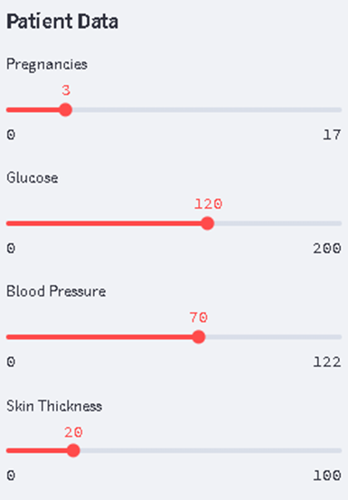
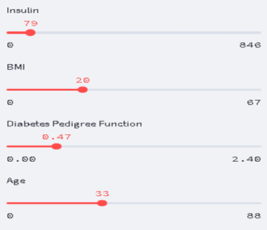
Fig: INPUT SLIDER-1
Experimental Results:
Fig: INPUT SLIDER-2

Slide 20
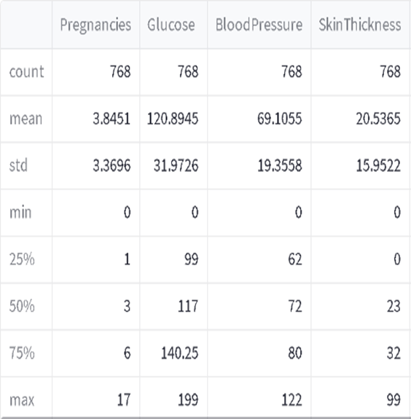
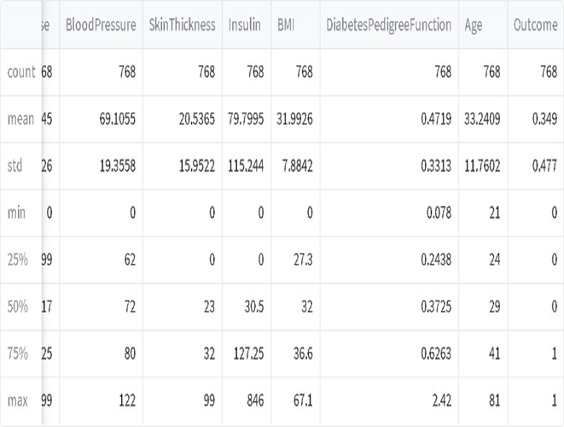
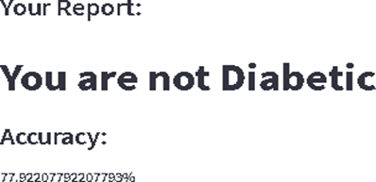
Fig: Training Data Stats-2
Fig: Training Data Stats-1
Fig: Output and Accuracy

Slide 21
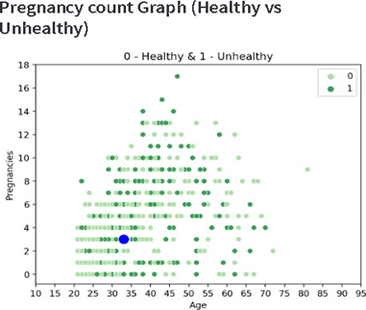
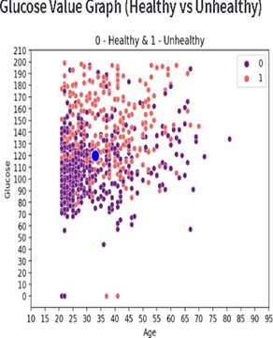
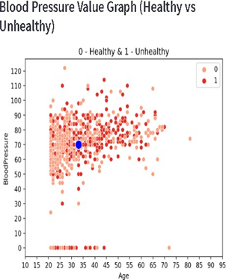
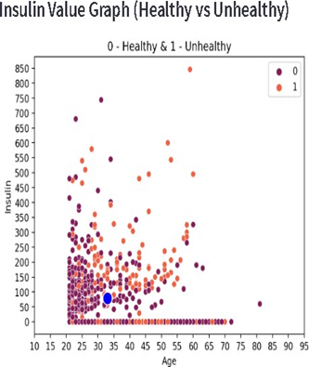
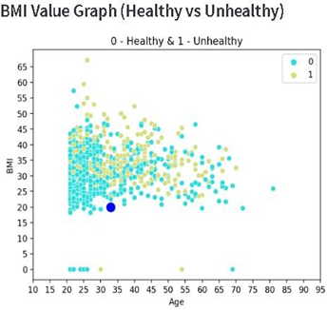
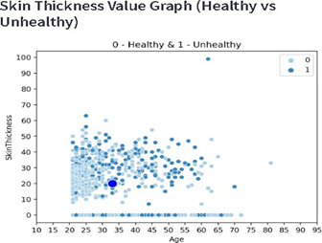
Pregnancy Count Graph
Glucose Value Graph
Blood Pressure Value Graph
Skin Thickness Value Graph
BMI Value Graph
Insulin Value Graph

Slide 22
Conclusion
Prediction of diabetes in pregnant women and neonatal mellitus in newborn children using machine learning revolves around developing predictive models to predict the risk of gestational diabetes in women expectant mothers and the likelihood of neonatal diabetes in newborns. By leveraging machine learning algorithms and analyzing various factors such as medical history, clinical parameters, lifestyle, and genetic predisposition, these models aim to provide early detection and personalized risk assessment. The goal is to enable healthcare professionals to intervene proactively, implement preventive measures.

Slide 23
References
Quan Zou , Kaiyang Qu , Yamei Luo , Dehui Yin, Ying Ju , Jun Zhang, “Predicting Diabetes Mellitus With Machine Learning Techniques”,(2018)DOI-10.3389/fgene.2018.00515
Lili Wei , Yueshuai Pan , Yan Zhang,“Application of machine learning algorithm for predicting gestational diabetes mellitus in early pregnancy”(2021),DOI10.2478/fon- 2021-0022
3.Thach Tran , Jane E.Hirst,“Prognosis Model for Gestational Diabetes Using Machine Learning Techniques”(2021),DOI10.2337/dc12-1418
Nora El-Rashidy , Nesma E. ElSayed,“Prediction of gestational diabetes based on explainable deeplearning andfogcomputing”(2022),DOI10.1007/s00500-022-07420

Slide 24
Thank You!

